Slide 1
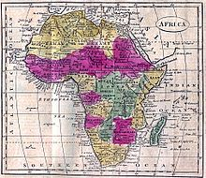
Colonization of Africa
Mrs. Majask
Global History

Slide 2
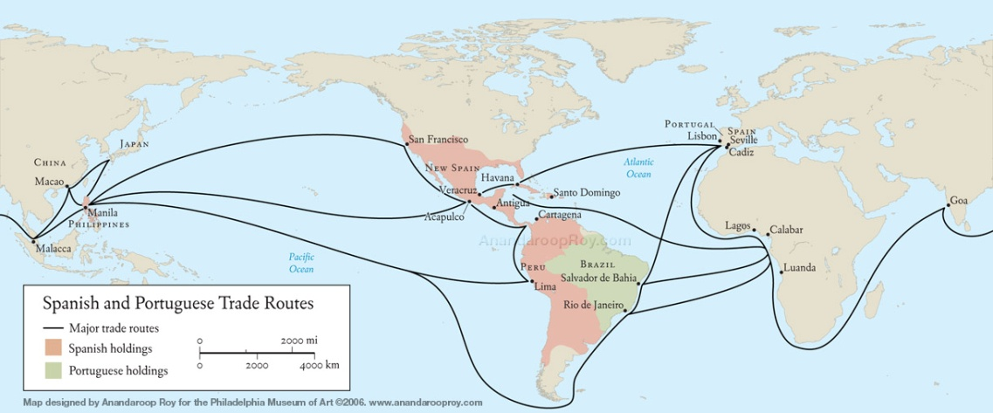
Exploration of Africa
1400s - Portuguese began to explore the west coast of Africa
Interested in Africa's gold trade
They also began trading slaves
More than 12 million people were exported as slaves

Slide 3
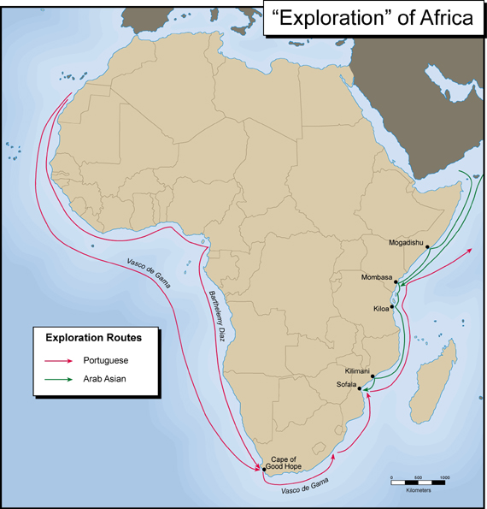
Merchants Arrive
1st - Merchant companies
Next - explorers and missionaries

Slide 4
European Powers Dominate Africa
By the 1880s, there were intense rivalries among the European nations as they staked claims to parts of Africa

Slide 5
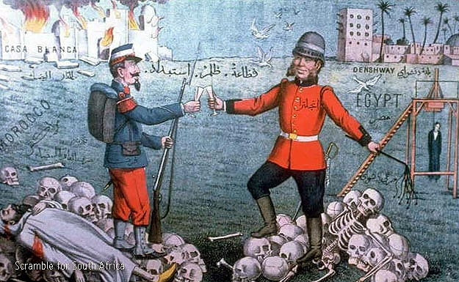
The Scramble for Africa
The race to expand European colonial influence is often referred to as the “scramble for Africa”

Slide 6
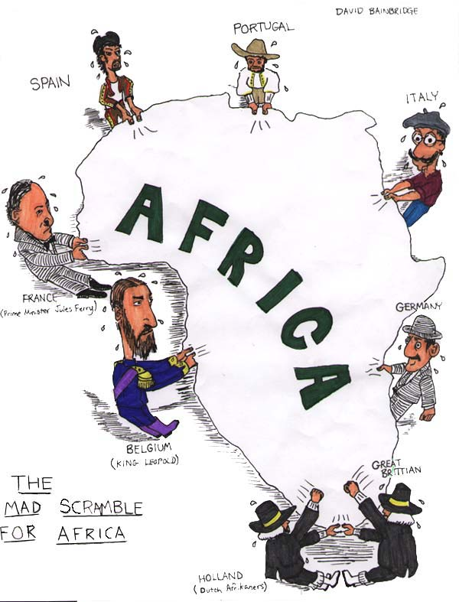

Slide 7
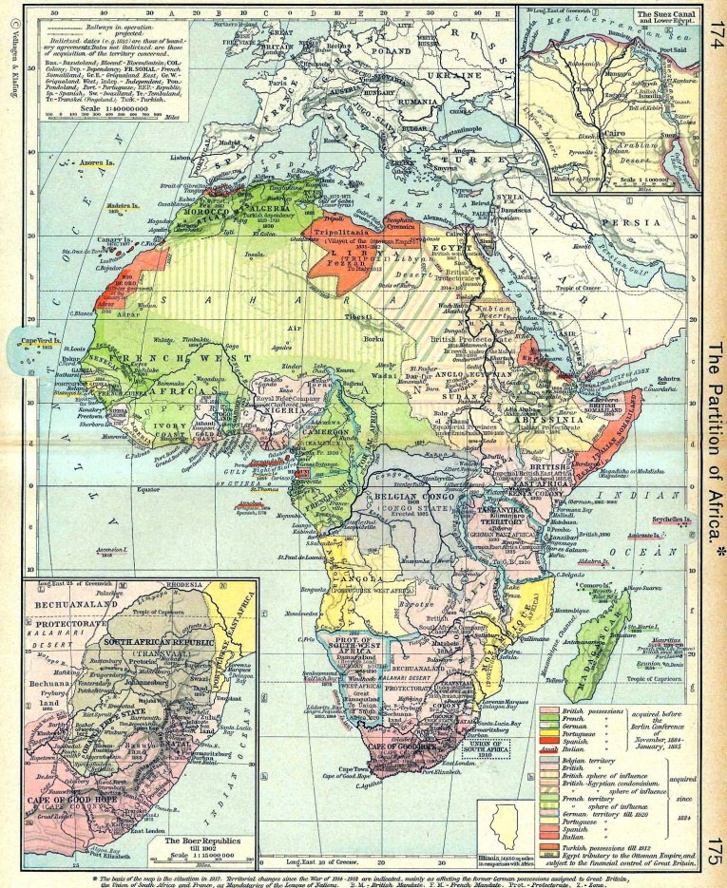
The Berlin Conference
In 1884, European powers convened the Berlin Conference
drew up rules among the nations establishing colonies
Goal to prevent war over claims to African lands
No Africans were invited to attend the conference

Slide 8
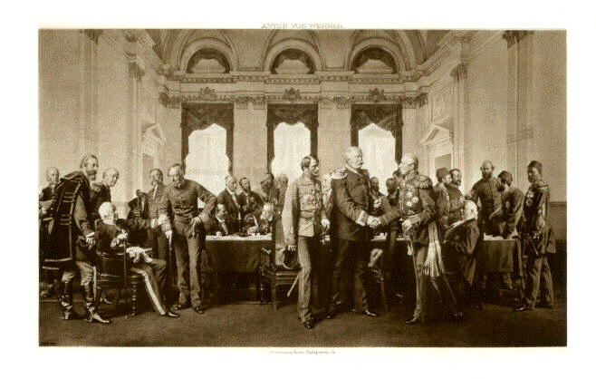
The Berlin Conference
The Berlin Conference provisions
Europeans had to occupy and administer their African lands
A nation already holding colonies on the African coast would have first claim on the interior parts of the country

Slide 9
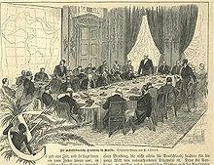
The Berlin Conference
The colonial borders that were established by Europeans cared little for national, ethnic, and religious boundaries
This caused lots of problems

Slide 10
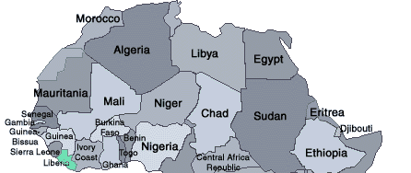
All Divided
By 1914, Belgium, France, Germany, Italy, Portugal, Spain, and the United Kingdom had divided almost all of Africa among themselves
Only Ethiopia and Liberia remained independent

Slide 11
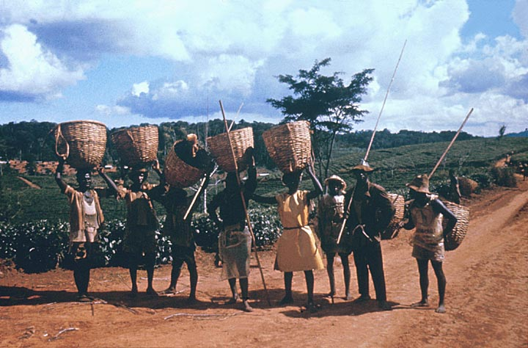
Results of Colonization
Millions of deaths directly in wars of conquest indirectly through the demands imposed upon them in colonial plantations

Slide 12
Seeking Independence
Some African colonies began to demand self-government in the early 1900s
Not until after World War II did the demands for independence become a powerful mass movement

Slide 13
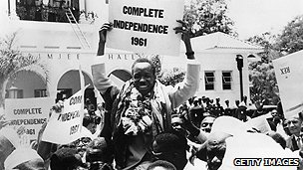
Seeking Independence
Finally, South Africa made the transition from apartheid (strict racial segregation) to a multiracial democracy under black rule in 1994

Slide 14
Source
Desanker, Paul V., Peri M. Klemm, Kenneth J. Perkins,
Kwesi Kwaa Prah, and Paul Tiyambe Zeleza. "Africa." World Book Student. World Book, 2010. Web. 10 Dec. 2010.

